Slide 1
Cryptography Fundamentals

Slide 2
Scope and Coverage
1 | Introduction to module
2 | Overview of security
3 | Overview of cryptography
4 | Block ciphers
5 | Public-key ciphers

Slide 3
Learning Outcomes
Cryptographic algorithm
1
Explain the most common types of cryptographic algorithm (i.e. block ciphers, public-key ciphers and hash algorithms)
About Security fundamentals
2
You can find out security fundamentals here.

Slide 4
Computer Security – Definition
“The protection afforded to an automated information system in order to attain the applicable objectives of preserving the integrity, availability and confidentiality of information system resources (includes hardware, software, firmware, information/data, and telecommunications).”
National Institute of Standards and Technology, Special Publication 800-12, (October 1995).

Slide 5
Cryptography – Definition
“The discipline that embodies the principles, means, and methods for the transformation of data in order to hide their semantic content, prevent their unauthorized use, or prevent their undetected modification.”
National Institute of Standards and Technology, Special Publication 800-59, (August 2003).

Slide 6
Security Objectives
NIST gives three objectives (FIPS199):
1. Confidentiality: Preserving authorized restrictions on information access and disclosure, including means for protecting personal privacy and proprietary information.
2. Integrity: Guarding against improper information modification or destruction, including ensuring information non-repudiation and authenticity.
3. Availability: Ensuring timely and reliable access to and use of information.

Slide 7
Loss of Security
The following defines a loss of security in each objective:
Loss of Confidentiality: Unauthorized disclosure of information.
Loss of Integrity: Unauthorized modification or destruction of information.
Loss of Availability: Disruption of access to or use of information or information systems.

Slide 8
The CIA Triad
These requirements (Confidentiality, Integrity, Availability) are commonly known as the CIA triad.
There are many critiques that suggest that this does not provide a complete picture of security requirements.
The two most commonly cited “extra” requirements are:
Authenticity
Accountability

Slide 9
Authenticity
Being genuine, verified and trusted.
Confidence in the validity of:
A transmission
A message
A message originator
Verifying that users are who they say they are and that each message came from a trusted source.

Slide 10
Accountability
Actions of an entity can be traced uniquely to that entity.
Supports:
Non-repudiation
Deterrence
Fault isolation
Intrusion detection and prevention
Recovery
Legal action

Slide 11
Security Attacks
It is useful to categories attacks as:
Passive attacks
Active attacks
Passive attacks make use of information from a system but do not affect the system resources.
Active attacks alter system resources or affect their operation.

Slide 12
Overview of Cryptography
Plain Text: Unencrypted information that may be input to an encryption operation. Note: Plain text is not a synonym for clear text. See clear text. (NIST)
Example: Prime minister will arrive at Gazipur at 4 pm
Cipher Text: Series of transformations that converts plaintext to cipher text using the Cipher Key. (NIST)
Example: !@#$% ^#&#*(%@

Slide 13
Overview of Cryptography
Encryption: Cryptographic transformation of data (called “plaintext”) into a form (called “ciphertext”) that conceals the data’s original meaning to prevent it from being known or used.
Example:
Decryption: If the transformation is reversible, the corresponding reversal process is called “decryption,” which is a transformation that restores encrypted data to its original state.

Slide 14
Cryptography
A collection of mathematical techniques for protecting information
Most important technique is encryption/decryption
Symmetric encryption (symmetric key encryption):
encrypt/decrypt a message using the same key
Key: a piece of information or sequence of bits
Asymmetric encryption (asymmetric key encryption):
one key used for encryption (public key), another key used for decryption (private key)

Slide 15
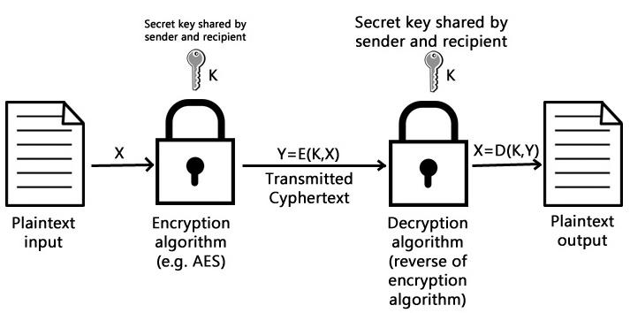
Symmetric Encryption

Slide 16
Elements of Symmetric Encryption
Plaintext
Encryption algorithm
Secret key
Ciphertext (encrypted text)
Decryption algorithm

Slide 17
Principle of Symmetric Encryption
Security of symmetric encryption depends on the secrecy of the key.
It does not depend on the secrecy of the algorithm.
Why?
It is difficult to invent new algorithms and keep them secret.
It is relatively simple to produce keys.

Slide 18
Requirements for Symmetric Encryption
Strong encryption algorithm:
The attacker should be unable to decrypt encrypted text, even if he/she knows several matching pairs of plaintext and encrypted plaintext.
The private key must be kept secret:
Sender and receiver must have obtained copies of the secret key (private key) in a secure way and must keep the key secure.

Slide 19
The Feistel Cipher
A scheme used by almost all modern block ciphers.
The input is broken into two equal size blocks, generally called left (L) and right (R), which are then repeatedly cycled through the algorithm.
At each cycle, a function (f) is applied to the right block and the key, and the result is XORed into the left block.
The blocks are then swapped.
The XORed result becomes the new right block and the unaltered right block becomes the left block.
The process is then repeated a number of times.

Slide 20
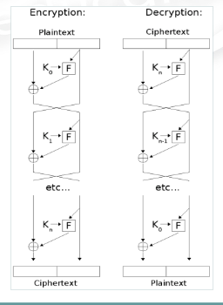
The Feistel Cipher

Slide 21
Data Encryption Standard (DES)
A standardized encryption algorithm approved by the U.S. government in 1977.
It uses a 56-bit key, which is sometimes stored with additional parity bits, extending its length to 64 bits.
DES is a block cipher and encrypts and decrypts 64-bit data blocks.
It is now considered insecure.
In 1998, a cracker could crack the key in 3 days.

Slide 22
Advanced Encryption Standard (AES)
AES replaced DES.
A fast block cipher, with variable key length and block sizes (each can be independently set to 128, 192 or 256 bits).
An official U.S. government standard since 2002.
Now widely used for commercial and private encryption purposes.
The algorithm is public, and its use is unrestricted, with no royalties or license fees owed to the inventors or the government.

Slide 23
Public Key Cryptography - 1
Uses asymmetric key algorithms
The key used to encrypt a message is not the same as the key used to decrypt it.
Each user has a pair of cryptographic keys:
a public encryption key, publicly available and widely distributed.
a private decryption key, known only to the recipient.

Slide 24
Public Key Cryptography - 2
Messages are encrypted with the recipient's public key and can only be decrypted with the corresponding private key.
The keys are related mathematically.
Parameters are chosen so that determining the private key from the public key is prohibitively expensive.

Slide 25
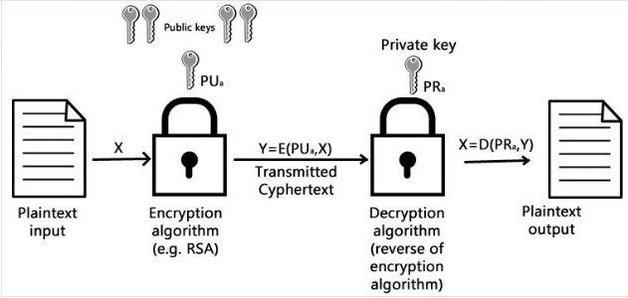
Public Key Cryptography

Slide 26
Public Key Cryptography - Applications
Encryption/decryption: the sender encrypts a message with the recipient’s public key.
Digital signature (authentication): the sender “signs” the message with its private key; a receiver can verify the identity of the sender using sender’s public key.
Key exchange: both sender and receiver cooperate to exchange a (session) key.

Slide 27
Hash Functions
A hash function is a mathematical function that converts a large, possibly variably-sized amount of data into a small datum.
Hashing is a method of binding the file contents together to ensure integrity.
Like using sealing wax on an envelope.
Only by breaking the seal can the contents be accessed, and any tampering is readily apparent.

Slide 28
Hash Function Requirements
To be suitable for message authentication, a hash function H should have the following properties:
H can be applied to a block of data of any size
H produces a fixed-length output
H(x) is easy to compute for any given x
For any value h it is very difficult (infeasible) to compute x such that H(x)=h
For any given x, it is very difficult (infeasible) to find y (not equal to x) such that H(x) = H(y)
It is very difficult (infeasible) to find any pair (x,y) such that H(x) = H(y)

Slide 29
The SHA-1 Secure Hash Algorithm
Takes as input a message with a maximum length less than 2 to power 64 bits and produces as output a 160-bit message digest.
The input is processed in 512-bit blocks.
Each bit of the output is computed using all bits of the input.

Slide 30
SHA-1 Examples
SHA1("The quick brown fox jumps over the lazy dog") = 2fd4e1c6 7a2d28fc ed849ee1 bb76e739 1b93eb12
A small change in the message will, with overwhelming probability, result in a completely different hash.
SHA1("The quick brown fox jumps over the lazy cog") = de9f2c7f d25e1b3a fad3e85a 0bd17d9b 100db4b3

Slide 31
Two-Factor Authentication (2FA)
In today's world, online security is more important than ever.
Two-factor authentication (2FA) is a simple and effective way to add an extra layer of security to your account.
What is Two-Factor Authentication?
Two-factor authentication (2FA) is a security process that requires two forms of identification to access an account.
The first factor is typically a password or PIN, which you already know.
The second factor is something you have or something you are, such as a fingerprint or a one-time code sent to your phone.

Slide 32
How Does Two-Factor Authentication Work?
When you enable 2FA, you'll need to enter your password as usual, but you'll also be prompted for a second form of authentication.
The second factor could be a code generated by an app, sent to your phone via text message, or even a physical key that you plug into your computer.
Once you provide both factors of authentication, you'll be logged in to your account.

Slide 33
Examples
Examples of Two-Factor Authentication:
Text message codes
Authenticator apps like Google Authenticator and Microsoft Authenticator
Physical security keys like YubiKey
Biometric authentication like fingerprints and facial recognition

Slide 34
Examples
Examples of Two-Factor Authentication:
Text message codes
Authenticator apps like Google Authenticator and Microsoft Authenticator
Physical security keys like YubiKey
Biometric authentication like fingerprints and facial recognition

Slide 35

Intellectual Property
Intellectual Property (IP) refers to creations of the mind, such as inventions, literary and artistic works, symbols, names, and designs, used in commerce.
It is protected by law, which allows the creators or owners to have exclusive rights to their creations.

Slide 36
Types of Intellectual Property
There are four main types of intellectual property:
Patents: protect inventions and discoveries.
Trademarks: protect words, symbols, and designs used to identify and distinguish goods or services.
Copyrights: protect original works of authorship, such as books, music, and movies.
Trade Secrets: protect confidential information that provides a competitive advantage.

Slide 37

ICT and Digital Security Act Bangladesh
The ICT and Digital Security Act Bangladesh was passed in 2018 to address the growing concerns of digital security threats in the country.
The act aims to protect against cybercrime, defamation, and other digital security issues.

Slide 38
ICT and Digital Security Act Bangladesh
Official website link: http://bdlaws.minlaw.gov.bd/act-1261.html

Slide 39
Key Provisions
The act includes provisions for punishment for offenses such as hacking, spreading propaganda, and cyber terrorism.
It also includes provisions for the protection of personal data and privacy.
The act allows law enforcement agencies to seize digital devices for investigation purposes.

Slide 40
Criticism
The act has faced criticism for its potential to limit freedom of expression and for vague language that could be used to suppress dissent.
Some critics have called for amendments to the act to ensure it does not violate fundamental rights.

Slide 41
Conclusion
The ICT and Digital Security Act Bangladesh is an important step towards ensuring digital security in the country.
While it has faced criticism, it is important to balance the need for security with the protection of fundamental rights.

Slide 42
THE END ANY QUESTION?

